Slide 1
‘Our Voices’: The First Meeting of the Reference and Dissemination Group
10th December 2014

Slide 3
‘Our Voices’ Project
To give children a voice in work to stop sexual violence against children
To support projects in Europe to develop participatory work with children who have experienced sexual violence
To support the empowerment of children who have experienced sexual violence to gain access to training and career development initiatives

Slide 4
The role of the Reference & Dissemination Group
Exchange learning
Identify and highlight priority issues for ‘Our Voices’ to consider based on gaps and challenges - in relation to prevention, sexual violence and participation

Slide 5
Objectives
Share updates from the ‘Our Voices’ project
Hear from other organisations to understand what work is happening on sexual violence prevention
Learn how others are involving young people in sexual violence prevention efforts

Slide 6
Objectives
So that we can..
Explore issues and gaps
Identify opportunities and priorities for future work
Lay the ground for/ develop further collaborative work

Slide 7
Expectations
1. Sharing and learning
Share own learning and examples
Listen to other people’s experiences
Hear young people’s own views on combating sexual violence
Learn what young people themselves are interested in

Slide 8
Expectations
2. To develop/ move forward
To come away with new and creative ideas
To identify gaps that could be addressed in the future through collaborative work
To look at the potential of developing a network of organisations
To see what ‘avenues for driving change’ exist nationally and in Europe

Slide 9
Expectations… that we may not fully meet today
Explore gendered challenges
Understand how to involve the views/ voices of parents
To share what’s been found to be effective/ what works
BUT
Please share examples, resources, ideas

Slide 10
Who is here and why!

Slide 11
During the day
Identify one example or piece of work that you would be interested in learning more about and will commit to follow up on after today

Slide 12
Ice-breaker
Write down on a post-it an example of:
something in practice that worked well to involve young people
something that didn’t work well

Slide 13
Update and emerging issues and ideas from ‘Our Voices’

Slide 14
‘Our Voices’ – the story so far…
Scoping
‘Call for information’ = 80
Website and mailing list
Consultations
Mapping participation resources
Opportunities
Ethics, sexual violence and participation

Slide 15
Consultations Thank you to partners!

Slide 16
Phase 1 –consultations
Identified countries
UK, Albania, Bulgaria, Spain, Netherlands
‘Call for interest’
Selected 2/3 partners per country
Developed plans and process

Slide 17
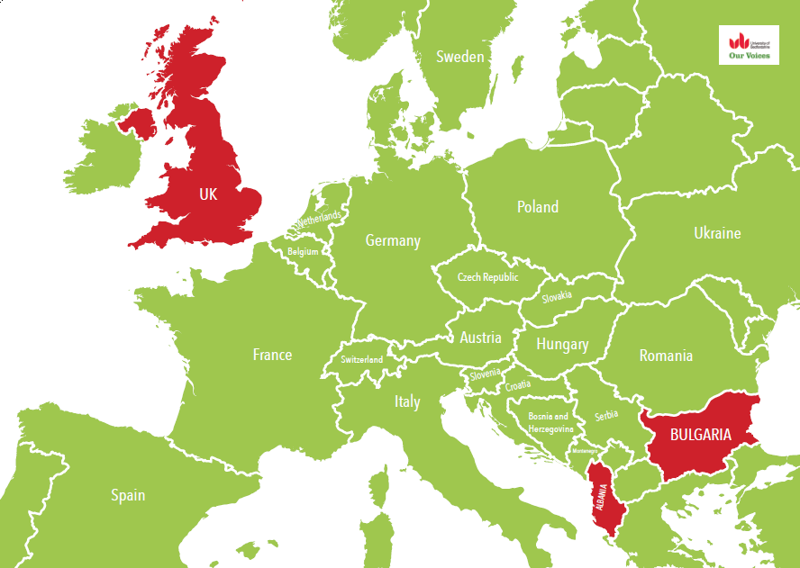

Slide 18
Young people involved
Partner | Country | # | Age |  | Knowledge/ experience of SV
ISIS | UK | 3 | 15-16 | F | Service-users - risk of CSE
Engage | UK | 6 | 15-20 | F | Service-users – risk of/ affected by CSE
SECOS | UK | 7 | 11-17 | F | Ex service users for different reasons CSE, CSA, carers
D&E | Albania | 6 | 18-25 | F | Ex service users affected by different forms of SV
Tdh | Albania | 8 | 14-18 | F | All in care being supported by various partners
PULSE | Bulgaria | 9 | 14-16 | F | Girls mainly from Roma community - school partner with PULSE
Gavroche | Bulgaria | 8 | 19-24 | M/F | Accommodated by service

Slide 19
Workshops
What do young people feel the issues are around sexual violence in their communities?
What are the barriers and challenges to young people talking about sexual violence and accessing support?
What do young people think could be done to stop sexual violence?
How could young people be more involved in preventing sexual violence?

Slide 20
Hopes
‘To get the word about and help other young people’
‘We hope that we will be heard’
‘I hope I can learn more about sexual abuse in order to inform the others about it’

Slide 21
Fears
‘We can’t prevent it – so why ‘hope’ to make a difference?’
‘Maybe our voice cannot change anything’
‘Will our project have the proper importance? Will it matter?’
‘There are many people who do not accept us because we come from a day centre. As if we cause trouble, they insult us and stay away from us’

Slide 22
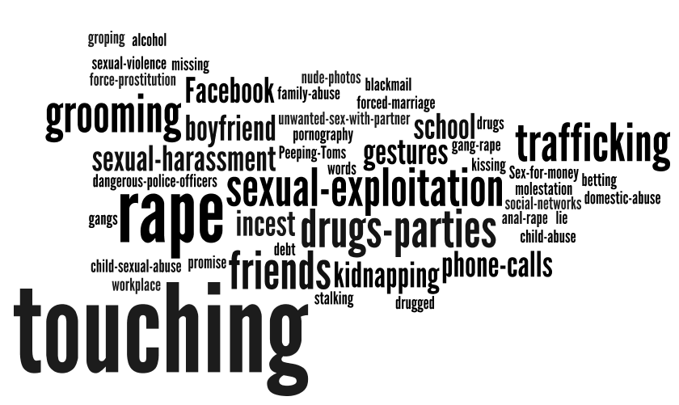
What’s happening here?

Slide 23
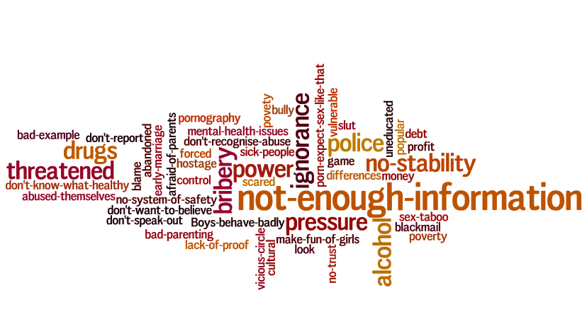
Why?

Slide 24
Barriers to understanding, talking about, seeking help and reporting SV

Slide 25
The role of schools
‘In schools they don’t talk about it enough’
‘The state is responsible for every child to know about it’
‘Certain topics on sexual education in school are not treated at all but overlooked due to the taboos that we have as a society’

Slide 26
Experiences in schools
‘The teacher never explained the lesson on reproductive system, she used to pass it and go to the other lesson’
‘It needs to be more than once – sexual health once and then never again’
‘When they did it in our school we got put in groups with strangers – it’s a hard subject to talk about you need to trust people – I like to get to know people before I talk to people about it’
Groped and kissed

Slide 27
The role of family
‘Parents don’t want to talk about it’
‘All girls agreed that speaking with their parents on topics that included sexual education was not possible’

Slide 28
‘We don’t know who to talk to’
‘Don’t know where to go’
‘Lack of information about the location of assistance centers and what services they offer’
‘Don’t understand procedures’
‘They don’t believe they are going to get real help’

Slide 29
Shame
‘Because talking about sex is taboo in our culture’
‘They feel shame to talk about the topic’
‘Fear of being in the spotlight and she will be ashamed of it’

Slide 30
Embarrassed and judged
‘It isn’t something people wanna talk about’
‘Don’t want more people knowing about it’
‘You will be humiliated so leave it, forget it’
Labelled, judged, treated differently and discriminated

Slide 31
Blamed and not believed
Fear of being blamed
‘Albanian mentality where people discriminate and prejudice abused persons, blame the victim and the victim feels ashamed’
‘You might think you led them on’
‘You might be called a liar and attention seeker’
‘They don’t wanna be called liars in court’

Slide 32
Repercussions
‘Children are afraid of their parents because they do not support them. if something happens they would blame their child for everything.’

Slide 33
Repercussions
‘If they report and the abuser finds it out, he may kill a family member’
‘Even if he does get arrested, his mates could come after you’
‘There are cases when the abusers stay in prison only for some couple of months and then they are free again’

Slide 34
Police
‘The police will not pay attention to you’
‘If you don’t actually say the word no, the police don’t believe you or won’t do anything about it’
‘They don’t report it to the police - why? Police just report it to one person, then another, then the judge’

Slide 35
In Albania…
‘being laughed at’
‘The police sometimes get very disturbing, requiring more intimate details of what happened, and then commenting between them in the person's presence about the details. This makes the abused person feel bad ’
‘The information given to the police passes to the media without any problem and the case becomes public’

Slide 36
Police
Not knowing procedures
‘Don’t know .. If it’s worth reporting, if it’s a serious enough issue’
‘If someone has been raped they need this test, then that test they have to have an interview, it’s really scary. And the thought of it being recorded and your voice kept it’s like re-living it, no closure - it can knock you’

Slide 37
What needs to change?

Slide 38
Education and information
Schools
Better education in school - needs to be fun
Built into curriculum
Parents
Educate parents in after school sessions
Community
To share information about services
Media
To share information through the media

Slide 39
School setting?
‘Schools don’t solve problems, shouldn’t be school or in a school environment – if it’s in school its going to be boring. Teachers tell you what to do rather than help you with what you’re going through’
‘Somewhere where there’s no wrong or right answers’

Slide 40
‘Talk about it!’

Slide 41
More/better services
‘Have better services in schools’
Need to be not like school
‘You don’t go looking for help you need it to come to you’
‘You don’t know where to go for help- unless the facility is brought to you’

Slide 42
How can young people be involved?

Slide 43
How can young people be involved?
Awareness trainings
Workshops
Developing information/ campaigns (on websites/ social media/ media )
Peer to peer education
Volunteering / Ambassadors

Slide 44
‘Would be weird’
‘How could we prevent it ? – not batman - but would be weird talking about it to someone’
‘Feel stupid talking to young people about experiences - wouldn’t have the bottle to speak at conferences’

Slide 45
Specific ideas
Go into schools, youth clubs
Develop a play to be staged in schools/ concerts
Make films, posters, leaflets and disseminate (toilet doors, shopping centres etc. )
Petitioning and lobbying
Write letters to famous people (rappers)
Graffiti walls

Slide 46
Why should young people be involved?
‘In order for the message to be interesting it has to be created by young people and the language to be cool’
‘We know how to explain things – adults dodge about it – we say it how it is’

Slide 47
Because…
We know how young people think
We talk the same language
We have more information
It’s better to learn from peers
We have personal experience to share ‘it makes it real’
We’re not ‘too professional’
We have energy
‘We’re the future of the country, change starts from ourselves’

Slide 48
What helps young people get involved in prevention work?

Slide 49
Practical tips
Its got to be fun/ creative
Know what getting into
Group – size and dynamics
Expenses / incentives
Qualifications and references

Slide 50
Training
‘We must be trained for specific techniques and games in order to explain sexual violence’
Offer training to young people that’s interesting and entertaining – fun to do’
‘In trainings experienced people should take part – both young and old…’

Slide 51
What would prevent young people from getting involved?

Slide 52
‘Wouldn’t want to be part of it if wasn’t official and you didn’t look official. I’d want a badge or summat to say I was part of ISIS. I think I look too young, so people wouldn’t take me seriously if I didn’t look official’

Slide 53
Practical tips
‘if it was just said that you were gonna be sat down doing work’
Too time consuming
Lone working
Lack of funds/ incentives/ resources

Slide 54
Potential problems
Not wanting to re-live experiences – protect
If experiences recent and raw
Not wanting to speak in public
Fear of perpetrators

Slide 55
Stigma and association
‘A girl can be stigmatized if she gets involved in information sessions about sexual violence, because we don’t talk about sex’
‘Issues with families because they do not support or understand if the question is about sex’

Slide 56
Stigma and association
‘I would really like to go into school but not my school or a school where people know me’
‘It would be good if they didn’t know us, maybe go to different areas’
‘Still scared can be judged’
‘Don’t want to be identified’
Notes:
Also fear

Slide 57
Language
‘Sexual violence is what it is so you’ve got to use that language - there is no point in sugar coating’
‘Change words – sexual violence harsh – difficult to say.. Sexual abuse? Abuse sounds worse! Violent – more aggressive ‘sexual happening’? Not specific enough’
Notes:
Also fear

Slide 58
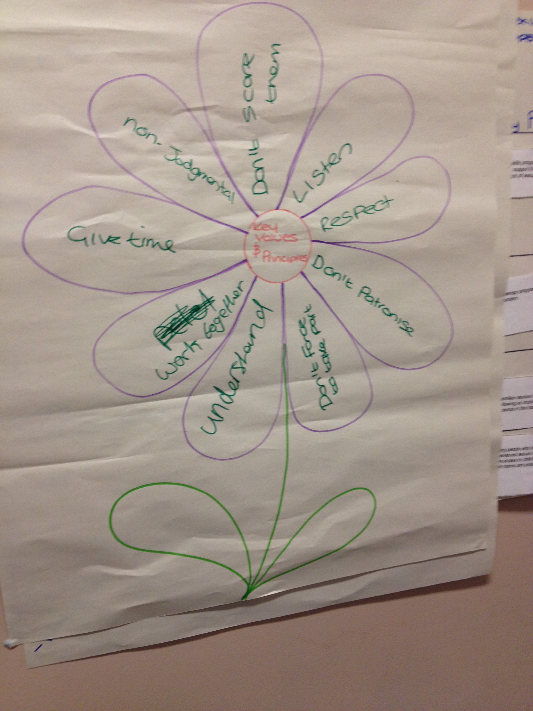
Principles

Slide 60
Learning – the good and the bad

Slide 61
Thoughts, reflections?
Other issues ?

Slide 62
Please leave our Youth Advisors a message

Slide 63
Barriers to…
Participation
Understanding/ talking about SV
Young people feel that people won’t listen to them/ nothing will change
Feel they may be stigmatised if involved
Lack of education in schools
It’s a taboo - attitudes of family, community and police
Talking about it and knowing who to talk to

Slide 64
Group work
Is this an issue that you’ve identified in your own work?
Are there other problems associated with this?
How have you tackled this issue/ challenge in the past?

Slide 65
What’s next for ‘Our Voices’?

Slide 66
Outline of ‘Our Voices’ grant
To give children a voice in work to stop sexual violence against children
To support projects in Europe to develop participatory work with children who have experienced sexual violence
To support the empowerment of children who have experienced sexual violence to gain access to training and career development initiatives

Slide 67
So…..
‘Will we actually get the opportunity to go to other projects in Europe to see what they have done and share?’
‘What about being part of prevention work and going into schools and stuff. Will that actually happen or is it just Micky Mouse?’

Slide 68
Potential projects
Sharing the learning from the consultations
Developing ideas from the consultation
Working with Youth Advisors now

Slide 69
Other areas not directly from consultation
Formalise and develop the Our Voices Network into a more active network
Develop stand-alone training guide for practitioners around participatory practice with young people on sexual violence issues in collaboration with Youth Advisors
Review opportunities for young people to feed into policy in Europe

Slide 70
Anything else?

Slide 71
Group work – Strengths/ weaknesses
How useful would this be to the wider sector?
Is it already being done by others?
Are there opportunities for collaboration?

Slide 73
Planning
Pick a group
Plan out the steps needed/ involved in making it happen (e.g. the who, how, what, when)
What opportunities are coming up in the next year to really push the work forward and influence?
Feedback and further discuss

Slide 74
The role of the Reference & Dissemination Group
Exchange learning
Identify and highlight priority issues for ‘Our Voices’ to consider

Slide 75
Does this work?
Need to communicate in between – best way?
Who else should be here?

Slide 76
Sum up
Next steps
Evaluation

