Slide 1
Making safe spaces to talk about unsafe relationships: bringing young people into the dialogue around preventing and responding to sexual violence
Claire Cody and Dr. Camille Warrington
June 2015
Not to be reproduced without permission from the author
Notes:
Good afternoon everybody
This afternoon I’m going to be talking about how we, as researchers and practitioners, can make safe spaces to talk about unsafe relationships with young people with and look particularly at how the IC at the UoB has involved young people in projects that focus on preventing and responding to SV

Slide 2
Outline
Why we feel it’s important to involve young people in our work
Examples of projects
Dilemmas and challenges
Strategies
Notes:
So just to give you an outline
I’m going to explain what the IC is and what it does
Why we feel its important to involve yp, particularly young people affected by sexual violence, in research and consultations about sexual violence
I’ll then go on to share a few examples of projects the IC has been involved in and talk about the issues and dilemmas that have arose and some of the strategies that we have put in place to promote participants safety, well being and to manage risk
I’l then conclude by looking at what we ‘re learning and ways we’re looking to move forward this work

Slide 3
International Centre: Researching Child Sexual Exploitation, Violence and Trafficking
Collaborative approaches
Meaningful and ethical engagement of children and young people
Notes:
So the International Centre is based at the Institute of Applied Research at the University of Bedfordshire in the UK
We have a team of 15 staff
And the aim of the Centre is to increase understanding and improve responses to CSE, violence and trafficking in local, national and
international contexts.
And we do that through
Working in partnership with organisations, particularly services supporting young people affected by these issues
And through meaningful and ethical engagement with children and young people

Slide 4
Why child and youth participation?
Key stakeholders
Distinct insight and expertise
Making the link: child participation and protection
Notes:
So why is meaningful CYP participation important for the centre and the work that we do? Particularly engaging with young people affected by sexual violence - well
Because we recognise that children and young people are key stakeholders – we know that young people are affected by sexual violence and that it is a concern for many young people
But we also know that young people have distinct insights and expertise in these areas – they know what the key issues are for them and their peers
In addition research indicates that involving young people in creative activities, and participatory engagement tend to involve creative work can have a positive impact for those young people –and I’ll go into more detail on this in a moment

Slide 5
Why involve young people affected by sexual violence?
Common consequences of exploitation
Common benefits of participation
Don’t always recognise harmful/ exploitative situation
Lack of power/control (Warrington, 2013)
Isolation (Reid and Jones, 2011;Taylor-Browne et al., 2002)
Stigma (Brown, 2004)
Low self worth/ self- confidence
Better understanding of own situation (AYPH, 2014)
Agency and decision-making power
Sense of belonging (Hagel, 2013)
Identity and approval (Batsleer, 2011)
Helping others (Batsleer, 2011, Levy, 2012, AYPH, 2014)
Notes:
So in terms of how we think participatory engagement with young people affected by SV can have a positive impact then
We know from research that there are some common consequences of sexual exploitation for young people
So we know that often young people do not recognise that they are being victimised and may believe that they are in a normal relationship or what is happening is simply what is expected.
Evaluations with young people affected by exploitation who have taken part in participatory projects however indicate that through such engagement young
people gain a better understanding of their own situation and start to see and understand what is a healthy and unhealthy relationship[
We also know that during episode of exploitation young people often lack power and control they don’t get to make decisions or may be operating in situations where their choices are constrained. Therefore for young people exiting these situations, having the ability to take back some power and control and have be heard are potentially even more important for young people who have experienced sexual violence
We also know from research that young people are often purposively isolated from family and friends and that unhealthy relationships can put a strain on positive relationships and young people therefore often feel alone and isolated and may be warey of starting new relationships. One of the most reported outcomes from young people who take part in participatory projects is that they feel a sense of belonging and connectedness through working with others on something that is concrete and meaningful
Stigma is also something that young people often struggle with. Young people often report being called names and feeling discriminated against due to their experiences. Yet again research shows that when young people affected by sexual exploitation take part in positive activities they can develop new positive identities as helpers, artists or film-makers for example and their work is recognised and leads to a sense of approval
And finally we know that young people affected by sexual violence often suffer from low self worth and confidence and again young people who are involved in activities that aim to improve responses for other young people or prevent sexual violence of others often say that one of the best things about getting involved in activities and projects is that they’re helping others and raising awareness, turning something that has been negative in their lives into something positive
Challenges cultures of silence in which abuse flourishes helping facilitate children own voice and our ability to listen
Builds on children’s access to knowledge, understanding of their rights and therefore own protective and help-seeking strategies.
Enhances services ability to protect children by promoting active engagement
Avoids creating welfare services which reproduce power imbalances that already characterise many children and young people’s lives
Improves our understanding of children’s lives and how to respond appropriately to risk and abuse.

Slide 6
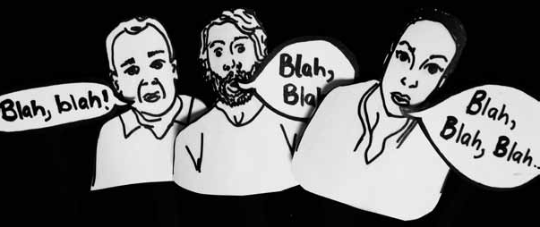
Projects at the International Centre

Slide 7
Be Healthy
Improving responses for young people affected by CSE
The Association for Young People’s Health (AYPH) and three specialist services
2 year project
10 Health Advocates
Notes:
So then just to give a couple of examples of projects the IC have been involved in then before I go through some of the challenges and strategies that we have used and continue to develop
The Be Healthy project trained young people affected by sexual exploitation to become health advocates. This project aimed to highlight and address the barriers to health services experienced by young people affected by sexual exploitation.
The project was a partnership with the Association for Young People’s, the International Centre and three specialist support services in the UK.
It involved ten young people who were accessing support from these three specialist youth services.
The Health Advocates were involved in a series of workshops exploring health issues related to sexual exploitation.
Following these workshops young people developed a number of resources to share messages including short animated films and a booklet written with them to explain how the films could and should be used in schools and other settings (AYPH Be Healthy, 2013).
The health advocates received accreditation for their work and have presented at a number of different events to different groups.
Two of the young people are now developing their own project focussing on peer support

Slide 8
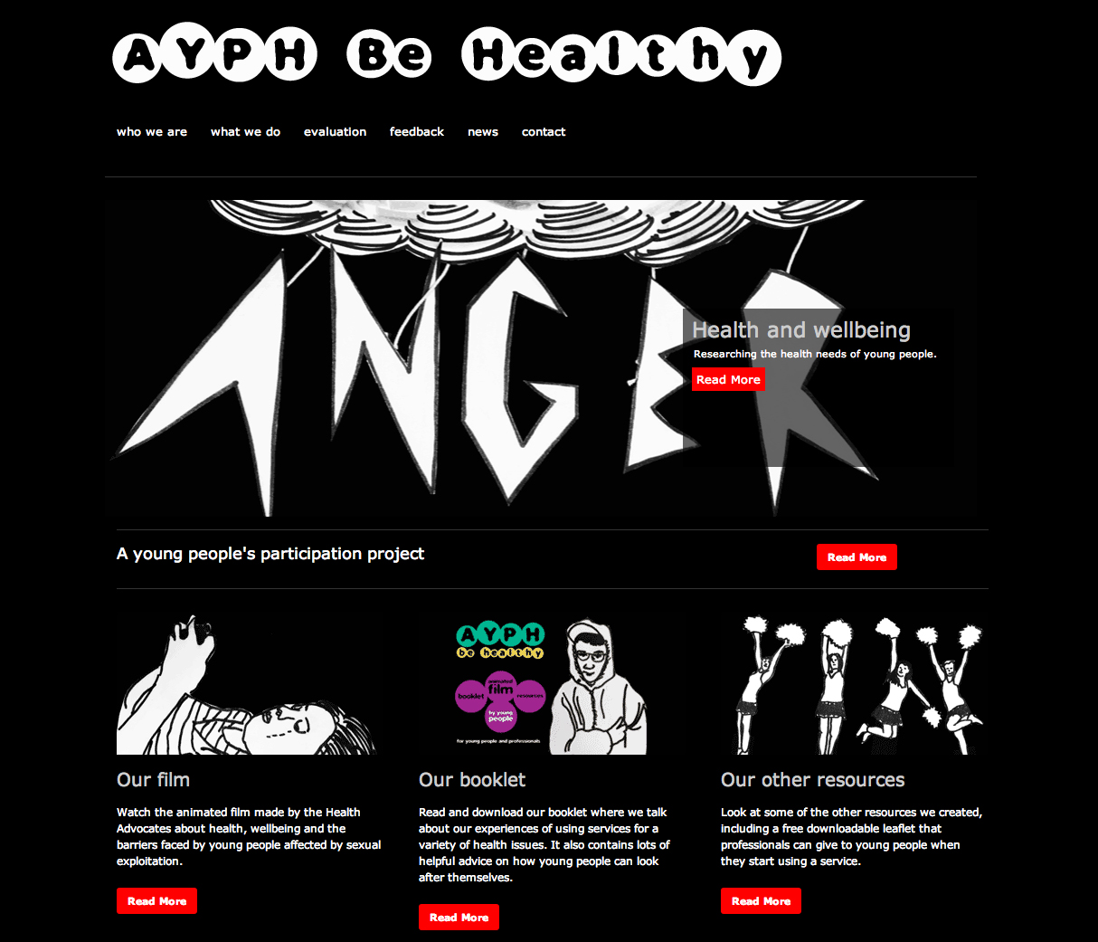
http://www.ayphbehealthy.org.uk

Slide 9
Making Justice Work
Improving responses CJS
Police investigations
and the courts
Three specialist
services
9 young people
Mapping the journey
Recording stories
Group discussions
Forum Theatre
Residential workshop
Prioritising and ranking our ideas
Notes:
Making Justice Work
The project was led by my colleagues Helen Beckett and Camille Warrington and explored with young people who had experience of the criminal justice system their experiences of police investigations and the courts
The research was done in collaboration with three local specialist projects
And the project drew on participatory research methods learning from service users' expertise to identify means of improving the system
The project involved young people as 'experts' rather than 'victims‘ and in addition to working with the researchers developed a short film to share their messages

Slide 10
Young people’s film

Slide 11
‘Our Voices’
The involvement of young people in sexual violence prevention efforts
Workshops in Albania, Bulgaria and the UK
Views and ideas
47 young people
Dissemination and action
Notes:
And thirdly, Our Voices
So Our Voices is a pan-European project which aims to promote the involvement of young people affected by SV in prevention efforts
One of the first activities we did for OV was to work with seven partner projects in the UK, Albania and Bulgaria to identify youth advisors that we could work with during the early stages of the project to get a sense of what yp felt were happening in their local contexts, what they felt the barriers and challenges were for young people when it came to understanding SV and getting advice and support, what needed to be done to prevent sexual violence and how young people could be involved .
At the IC we developed a series of interactive workshop plans that aimed to stimulate discussion and to involve young people in mapping and raking problems and solutions in their local communities
We are now moving into the second phase of this project and are sharing and building on the views and ideas from Youth Advisors to fundraise for further work and are now working with the Youth Advisors to help in the dissemination of the messages from the consultations

Slide 12
What are we learning?

Slide 13
Risks/ challenges
‘Too vulnerable’ - risk of re-traumatisation
Group work seen as risky
Variance of groups - over 18/ under 18
Legal implications – disclosures, ‘contaminating evidence’
Anonymity versus acknowledgement
Ownership / editorial control
Relationships with the media
Notes:
So to run through some of the challenges or dilemmas the team have faced during this process then
Firstly, partner organisations often view the young people that they are working with as too vulnerable to take part and are often, quite rightly concerned about the potential of retraumatisation.
Many organisations working with young people affected by sexual exploitation tend to view group work as particularly risky and can be concerned that young people will influence others into risky situations
It can also be challenging when working in groups where there are differences so when you have young people who are under and over 18 for example different legal parameters may be in place and the project team will have different levels of responsibility. So for example if you are travelling with young people to attend a conference and there is an overnight stay and there are those over 18 years old who want to drink alcohol and those who are not 18 – how is that discussed and managed?
There are also legal tensions when young people for example are involved in on-going court cases there may be issues around how activities could be seen as to contaminating potential evidence in some way or when working with young people who disclose for example involvement in illegal, criminal activities
There are also tensions around anonymity and acknowledgement so when young people are involved for example in photography or film projects and they insist that they appear in these how do you work and support young people to think carefully about the balance between being acknowledged as the producers or co-producers of something but at the same time ensuring they think through the implications of breaking that anonymity
Also of course there is a risk that their involvement may actually lead to negative representations and that this may increase stigma rather than reduce it
One thing that young people have told us in the OV consultations is that getting involved in SV prevention efforts whether you have experienced SV or not may lead to stigma and in the case of Albania the young women involved talked about the problems this could lead to between a girl and her family
There are also challenges around ownership – and in one film project my colleagues worked on this was a real issue as young people wanted certain content to be in the film that the researchers and project workers felt was too risky. In the same project the project team were not comfortable with certain language that the young people wanted to use. Although there had been discussions about who had power initially, issues around ownership and editorial control were not fully explored and agreed upon
And then finally around relationships with the media – there is a thurst from the media for hard-hitting details about abuse and exploitation when in fact young people often want to talk about the project not their personal experiences and again this process needs to be carefully managed and young people supported

Slide 14
Strategies
Ethical clearance, protocols
Risk assessments
Ongoing support
Providing clear information – who has ‘the power’ !
Notes:
So this brings me onto exploring some of the strategies that the team have developed to address and explore with young people some of these challenges and dilemmas
So firstly of course ensuring ethical protocols are drawn up and understood by all partners involved is critical so that all partners are aware of the process and different thresholds etc
Secondly rather than trying to avoid risk, its important to recognise risks that can be appropriate managed and work together with all involved to manage those risks
And this means actually working with young people to ensure we identify risks and plan how to manage these together. In some projects his has been done effectively by simultaneously asking the facilitators/ adults to think through all the risks and their fears about what would go wrong as a group and asking young people to do the same and then to come back together to hear the risks so that all stakeholders are aware of each others concerns, can understand their perspectives and can work together to manage these. When we haven’t done this then when certain measures are put in place, young people don’t understand the reasoning or concerns that led to those measures being put in place and this can lead to frustrations.
Planning and having the right resources in place is critical and this means having funds to support local project staff as such work takes a lot of their time
Having support for young people in case engagement in discussions and activities triggers anything for them
But also having training in place if needed and support in place for staff so that they do not have to make difficult decisions or deal with challenging situations alone – but have support to discuss and respond
And providing clear information to projects and young people so they understand the project and what is involved – and here is an image from one of the OV consultation groups who were involved in this initial picture mapping exercise to understand the project who was involved and how the information would be used etc.

Slide 15
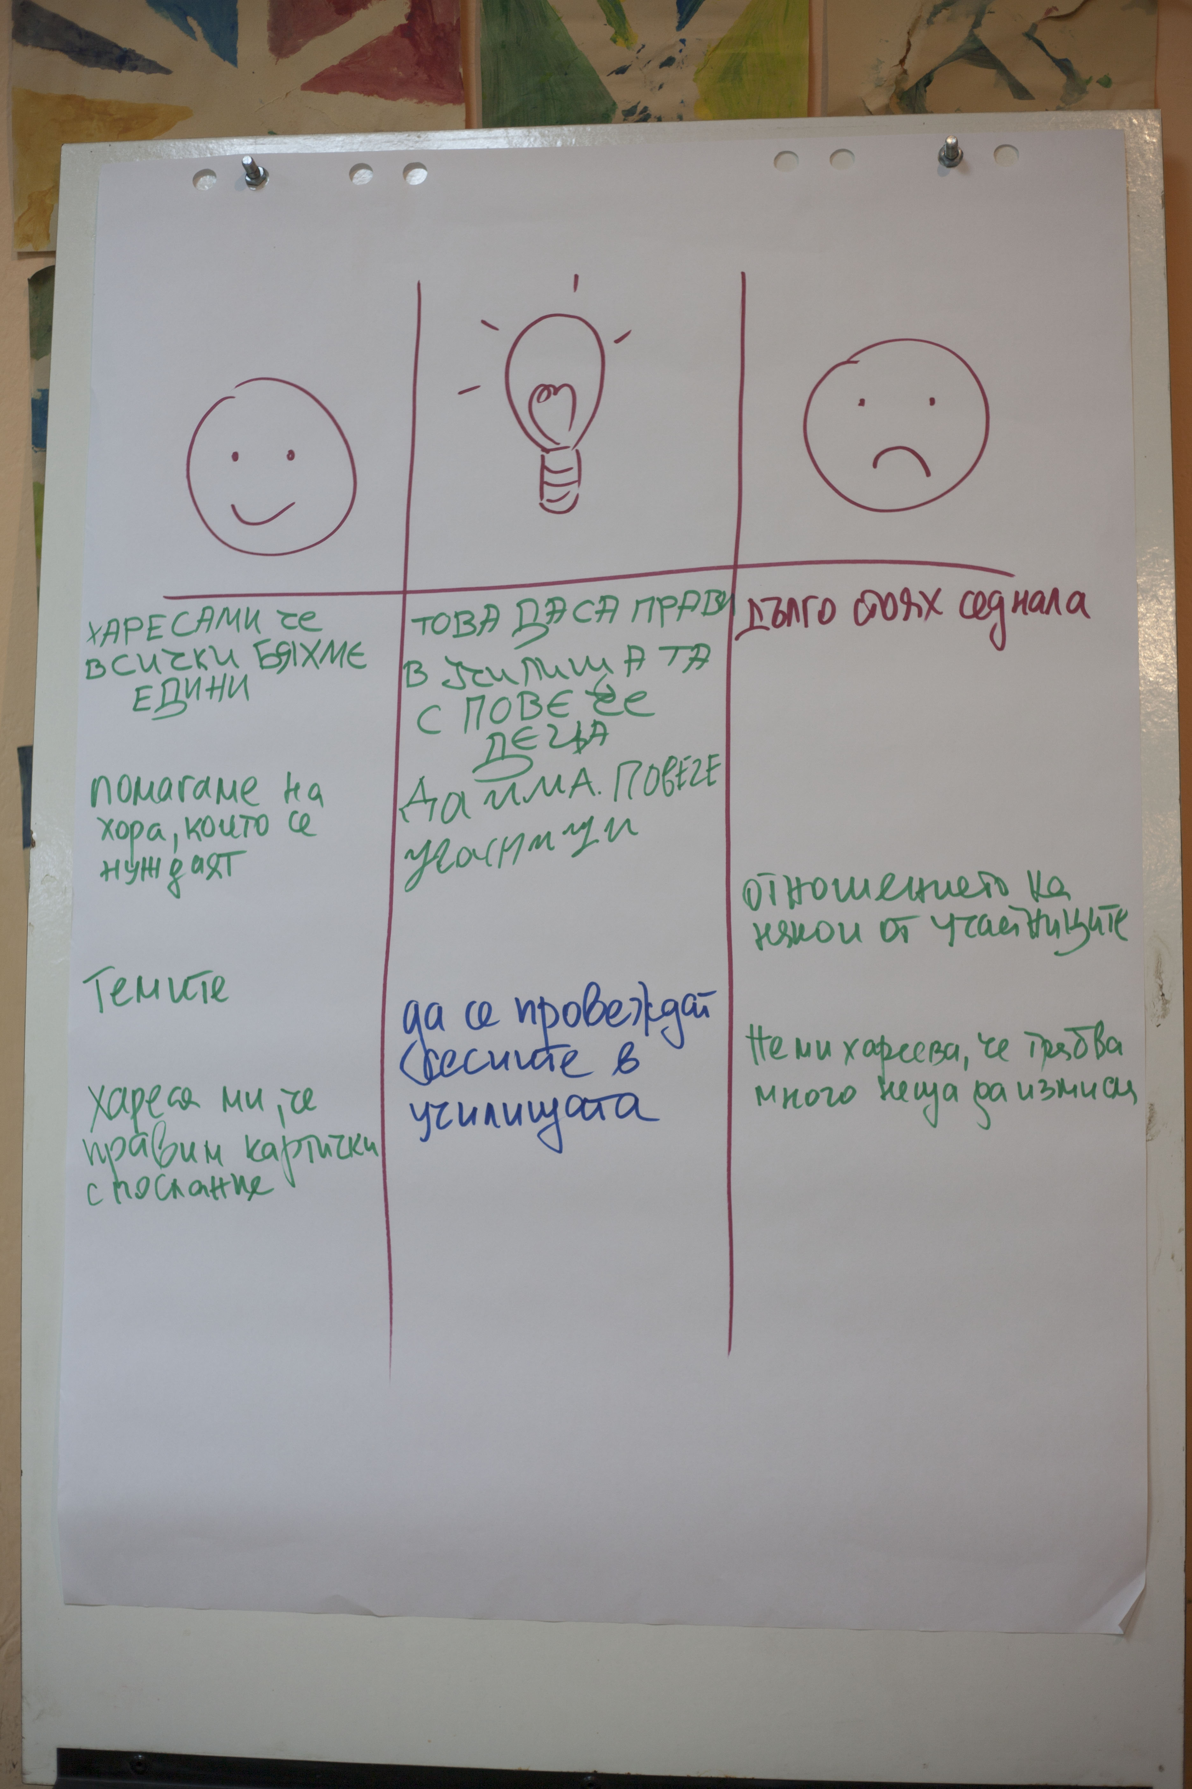
Strategies
Establishing safe spaces – ‘testing out’
On-going consent
Group agreements
Feedback from young people and services on process
Planning and preparation for dissemination
Notes:
Of course establishing a safe space is really important for young people and we use a number of strategies to enable young people to understand for example what confidentiality is, when we would need to disclose something
For example one exercise we often do at the start when discussion confident laity is to ask the group to take a tube of toothpaste and squeeze that out on a piece of card. We then aske them to try to get the toothpaste back in the tube and when the cant’ use this to explain that once something is spoken about in a group context it can not be taken back it is out there
We also work with groups by putting together a group agreement, where the group come up with what is acceptable or not acceptable and rather than leaving it like that we often ask young people to sign it and come up with sanctions around what will happen if this is broken. So for example in one of the OV groups the girls decided that if someone broke the agreement they would have to sing a song at the request of the others
We also ensure that we build in exercises to gain feedback and advice from young people about the process that we take
Ending relationships is hard and has to be done sensitively, another issue that we find is that often there are opportunities for young people to get involved in different ways, for example attending conferences, co-facilitating events with us and over time these young people are no longer accessing the services they had, with our policy of working through projects so they can give support this is something that we are still grappling with
And then finally dissemination – as I mentioned the media often want a certain type of story and young people need to be fully prepped and provided with media training and supported to weight up the risks and benefits of taking part
Also in conferences and workshops young people also have to be prepared for dealing with the inevitable insensitive questions such as ‘were you sexually exploited, what happened to you?’. There are ways to plan for this, such as determining who in the group, adult or young person will take that on and challenge that person for asking an inappropriate question, young people can be prepared for ways to side step uncomfortable questions by talking about the project not their own experiences
Aonynity to full public identity – remotely shifts – fully infomred choises how represented for different audiences – names / ppublication at a closed audience/ cot-trianing / interview in the media – isk assssment informed challeneges / if someone asks the questiobn that not approprate question
Varince within a group creaivel y
Never any pressure to share experiences
Parners / audiences – event how to appetite fo trauma stories agree with group
I don’t know experiences and I don’ need to know
Hiearcyh of oppression one group incluided a wmen not dieclty affected – spokesperson - assumptions manage
Framing third person vignetts and stories third person what might q young erson be thinking? How do you think
Balance not saying don’t want to hear what you’re saying
Media – crieria
Make informed decision - + and negative
BBC anonymously sruggles / frusration forever moved on – goof thin/ proud
Add defining the limies ownership – influence and control –exercise where ae the red lines wont give up control – visually up there no far enough limits contorl – professionlas langueage youth-led don’t challenge patnerships wihtout sharing how roles differ ok but clear as possible

Slide 16
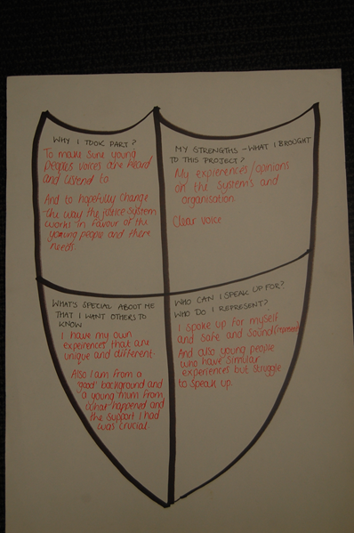
Who we are…
We are male and female, smart and caring, funny and beautiful, respectful and intelligent. We come from different communities and different parts of the country. Among us there is a Grade 7 pianist, a photographer, ‘a mummy’s boy’, an actor or two, music lovers, an artist, parents, animal lovers, and national award nominees and winners. Some of us are confident and outgoing, some of us are loud…….
Notes:
In many of the projects we’re involved in we also ask the group to determine how they would like to be represented or known as. So in the picture you can see a shield and in this exercise young people are indivually asked to think about and note down – why they took part, their strengths and what they brought to the project, what is special about them that they want others to know and who they can speak for or who they represent
This exercise ensures that that young people are not represented as simply a victim or a survivor

Slide 17
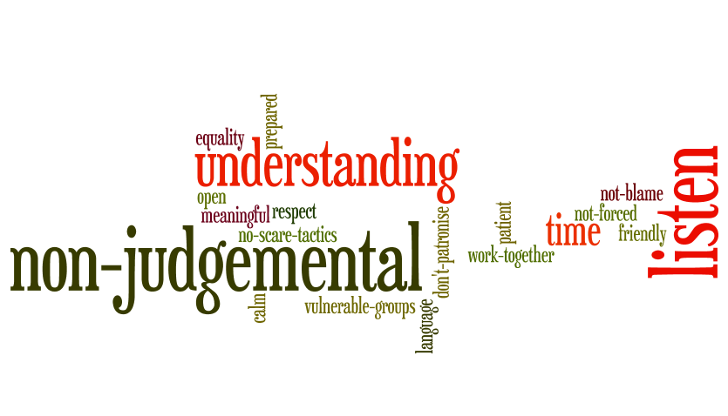
Principles for engagement

Slide 18
Young people affected by sexual violence as change-makers in prevention efforts: What are the opportunities and what are the risks?
Interdisciplinary conference
28th September, 2015
Cumberland Lodge, Windsor, UK
Call for papers 19th June
http://www.cumberlandlodge.ac.uk/Programme/Forthcoming+events/Participation+for+Prevention

Slide 19
claire.cody@beds.ac.uk
camille.warrington@beds.ac.uk
For more information on our work including research publications, short films and outputs from young people please visit
www.beds.ac.uk/ic

