Slide 1
Child and youth participation and regional cooperation: The ‘Our Voices’ project
Claire Cody
June 2015
Not to be reproduced without permission from the author

Slide 2
Outline
The ‘Our Voices’ Project
Why involving young people affected by sexual violence is important
What the Our Voices Youth Advisors say about prevention and participation
Why regional learning adds value

Slide 3

What is ‘Our Voices’?
Promote the involvement of young people in efforts to prevent sexual violence
Gathering the views and ideas of young people
Sharing learning
Promoting safe and ethical engagement

Slide 4
Why involve young people affected by sexual violence?
Common consequences of exploitation | Common benefits of participation
Don’t always recognise the harm | Better understanding of healthy relationships (AYPH, 2014)
Lack of power/control (Warrington, 2013) | Voice and choice
Isolation (Reid and Jones, 2011;Taylor-Browne et al., 2002) | Sense of belonging (Hagel, 2013)
Stigma (Brown, 2004) | Identity and approval (Batsleer, 2011)
Low self worth/ self- confidence | Helping others (Batsleer, 2011, Levy, 2012, AYPH, 2014)

Slide 5
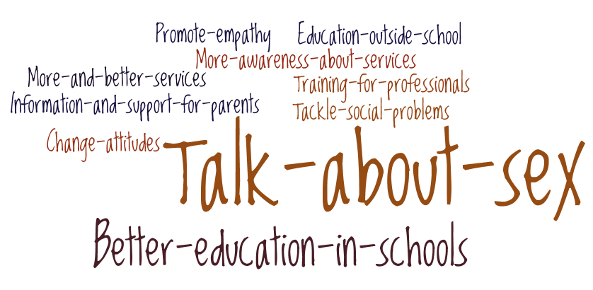
What needs to change?

Slide 6
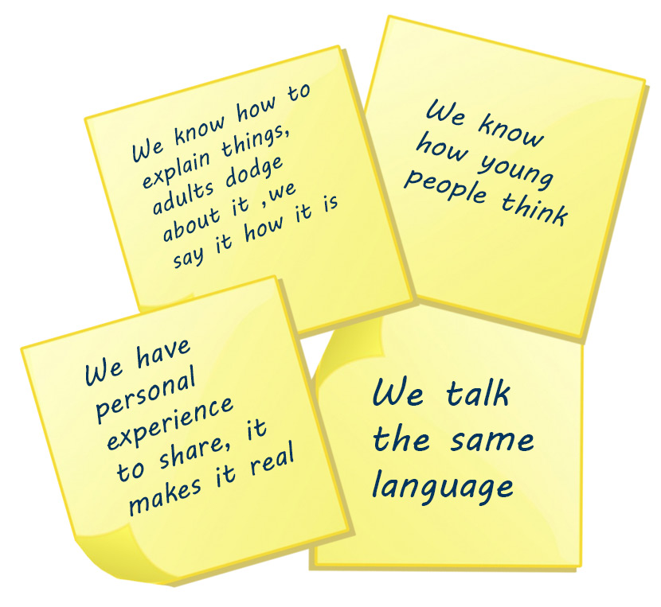
Why do young people think they should be involved?

Slide 7
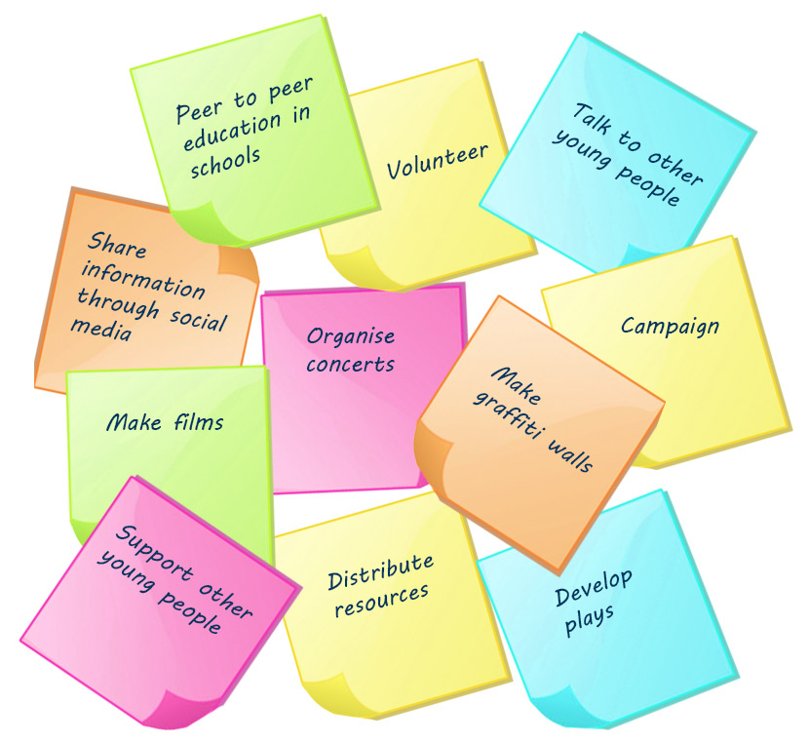
How do young people think they can be involved?

Slide 8
What helps and hinders participation?
What helps
What hinders
Give examples
Provide training
Use the right language
Make it fun
Make it feel safe and comfortable
Provide incentives
Too much time involved
Boring
Working alone
Not providing the right information or resources
Not providing incentives
Having had a bad experience
Increasing stigma
Fear
Re-traumatising/ reliving experiences

Slide 9
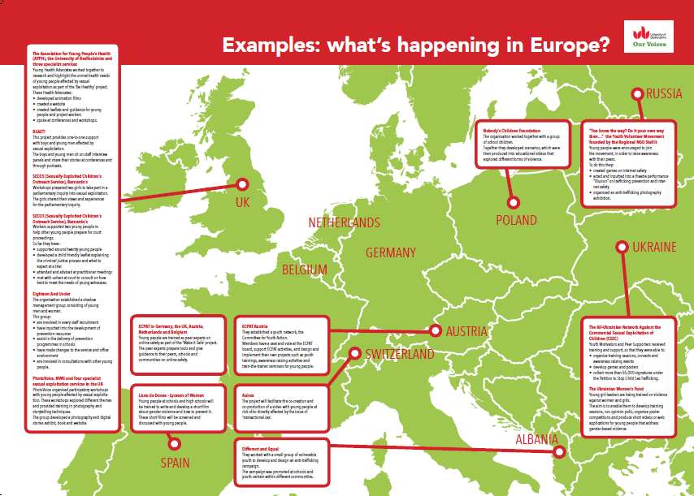
What’s the added value of a European Network?
Encourages
Inspires
Identifies common principles and challenges
Provides a common platform
Helps to have a shared voice

Slide 10
How can we strengthen and sustain such regional networks and efforts?
Challenges
Solutions
Time-limited projects
Lack of resources
Busy practitioners
No incentives to reflect and share our mistakes
Language barriers
Accessibility
Longer-term support
Resources
Involve multiple stakeholders
Time and incentives
Focus on ‘learning’ not ‘good practice’

Slide 11
claire.cody@beds.ac.uk
http://www.beds.ac.uk/ourvoices
For more information on our work including research publications, short films and outputs from young people please visit
www.beds.ac.uk/ic
Notes:
.

